Slide 1


Turas Analytics Engine

Slide 2
What is Turas?
1. Your Research Should Work Harder
You commission research, collect good data, and get a PowerPoint deck that answers the questions you asked at the time.
Then a new question surfaces. Someone has to go back to the analyst, reopen the dataset, and rebuild the analysis. That takes time and money. Usually it just doesn't happen.
Most research ends up as a presentation rather than a resource.
There is a better way.

Slide 3
Why You Can Trust It
2. What Turas Delivers
Turas is a survey analytics platform that transforms your dataset into an interactive analytical resource — one your team can explore, share, and return to without going back to the analyst every time a question changes.
You get rigorous statistical analysis run directly from your data, an interactive report your team can navigate themselves, and a permanent analytical record of your research.
One dataset. One report. Useful for as long as the data is relevant.
No subscription fees. No licence costs. You pay per project.

Slide 4
Why HTML Reports Are the Future
3. Built on Serious Statistical Foundations
Turas is built on R — the open-source statistical environment used as standard by national statistics offices, central banks, universities, and government agencies worldwide.
Because R is open and transparent, every calculation is fully inspectable. The methods behind every output can be examined and verified. Every result traces directly back to the underlying tables.
There are no proprietary black boxes. When a finding is challenged, you have a clean, traceable analytical record to stand behind.

Slide 5
Why HTML Reports Are the Future
4. Professional Oversight on Every Project
Turas is not a self-service tool.
The Research LampPost is an organisational member of the Southern African Marketing Research Association (SAMRA), the professional body that sets and upholds research standards in South Africa. Duncan Brett is a SAMRA-accredited researcher with over 30 years of experience in quantitative market research.
Every project is guided from data preparation through to final output. The right methods are applied, the data is structured correctly, and results are interpreted responsibly — not just generated automatically.

Slide 6
Why HTML Reports Are the Future
5. Your Data Stays With You
Your dataset is never uploaded to a cloud platform, shared with a third party, or processed on external infrastructure. All analysis runs on our own hardware, in a controlled environment.
Once the report is delivered, it is finalised and self-contained. It cannot be altered after the fact, giving you a stable record of exactly what the data showed at the time of analysis.

Slide 7
Why HTML Reports Are the Future
6. Fast, Consistent, Dependable
Traditional analysis can take weeks once a dataset arrives. Turas compresses that timeline significantly. For our first client report, a preliminary analytical output was available within a day of fieldwork closing.
Consistency is built into the process. When analysis is rebuilt manually, results can shift — different analysts, updated software, changed defaults. Turas runs within a controlled computational environment, applying the same methods every time. For tracking studies this matters particularly: results stay comparable across waves, and earlier findings don't quietly change because a software package was updated.

Slide 8
Why HTML Reports Are the Future
7. An Interactive Report, Not a Static File
Results are delivered as an interactive report that runs in any modern web browser. Nothing to install. No subscription. No licence to manage.
It works as a single source of truth for your research. Your team can browse all tables in one environment, switch between table and chart views, and cut results by any segment or subgroup — without waiting for the analyst.
Tables can be exported to Excel at any point, so Turas fits into existing workflows rather than displacing them.

Slide 9
Why HTML Reports Are the Future
8. From Exploration to Presentation
The report includes a pinned views feature that lets users capture key findings and build a narrative directly within the same environment.
Pinned views can include charts, commentary and images, and can be exported to PowerPoint or PDF when needed.
The same report supports analytical exploration and stakeholder presentation — without switching tools.

Slide 10
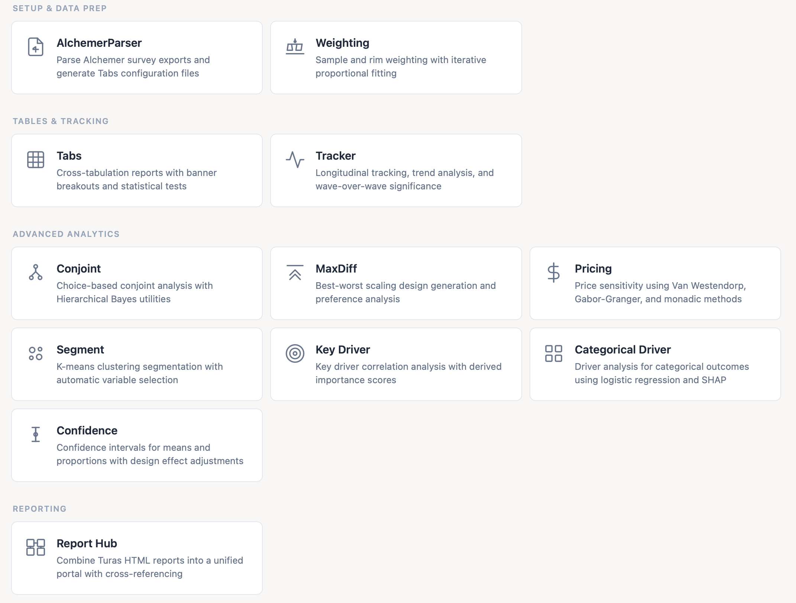
Why HTML Reports Are the Future
9. What Turas Can Analyse
Turas can incorporate a range of specialist analytical modules, all delivered within the same interactive report.
Tabs — automated crosstabs with frequency, column and row percentages, significance testing, and weighting.
Tracker — multi-wave trend analysis with significance testing and question mapping across waves.
Key Driver — identifies the factors with the strongest statistical relationship to key business outcomes.
Key Driver (Categorical) — regression-based analysis for categorical outcomes such as purchase decisions, segments, or customer tiers.
Segment — statistical clustering to identify natural customer groups beyond broad demographic averages.
Conjoint — discrete choice modelling with an interactive market simulator.
MaxDiff — precise preference rankings from balanced best/worst item sets.
Pricing — price sensitivity analysis using Van Westendorp and Gabor-Granger models.
Weighting — ensures the data represents your target population before analysis begins.
Confidence — rigorous validity testing that goes beyond standard significance flags.
Multiple modules can be combined into a single report.

Slide 11
Why HTML Reports Are the Future
10. What We Can Help With
Support is available throughout the project — questionnaire design, analytical planning, data preparation, and interpretation of results.
For most projects we also prepare an initial set of pinned views, giving your team a ready-made starting point rather than a blank report.

Slide 12
Why HTML Reports Are the Future
11. See It In Action
The most effective way to understand Turas is a live demonstration.
We can walk through a real dataset and show how survey data becomes a working analytical resource — from raw data to interactive report.

Slide 13
Sample Slides from Turas
Demonstrating report pin outputs

Slide 14
What Turas Can Do
Analysis Modules
Tabs
Tracker
Key Driver
Key Driver (Cat.)
Automated crosstabs with frequency, column %, row %, significance testing & weighting.
Multi-wave trend analysis with significance testing and question mapping across waves.
Identifies factors with the strongest statistical relationship to key business outcomes.
Regression methods for categorical outcomes — purchase decisions, segments, or tiers.
Segment
Conjoint
MaxDiff
Pricing
Statistical clustering to discover natural customer groups beyond broad averages.
Discrete choice modelling with an Excel-based interactive market simulator.
Precise preference rankings from balanced best/worst item sets.
Price sensitivity analysis using Van Westendorp & Gabor-Granger models.
Current operational modules (with more in development)
Supporting Modules
Weighting — ensures data represents your target population | Confidence — rigorous validity testing beyond standard significance flags

Slide 15
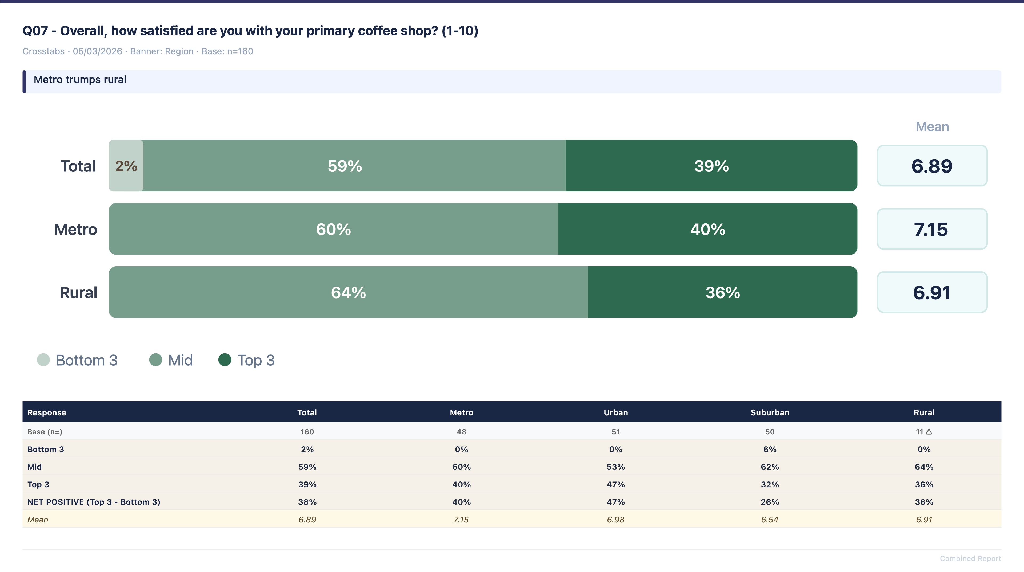
Overall satisfaction

Slide 16
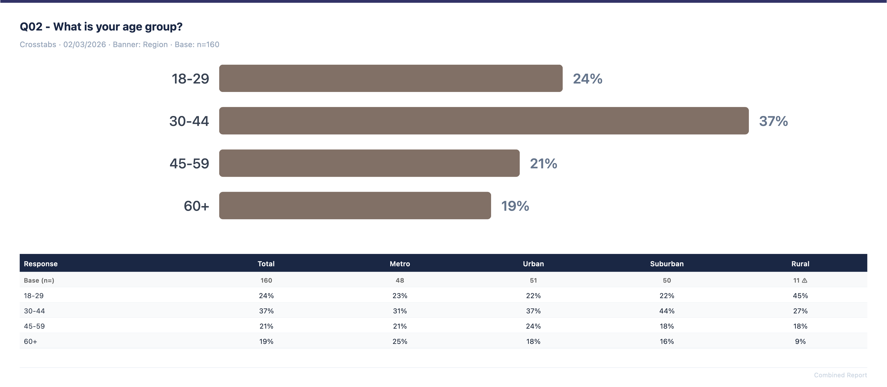
Age by region

Slide 17
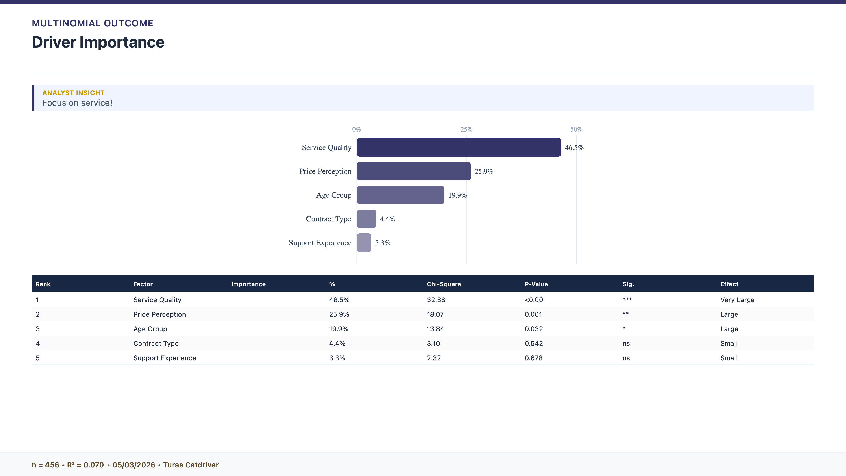
What is driving satisfaction

Slide 18
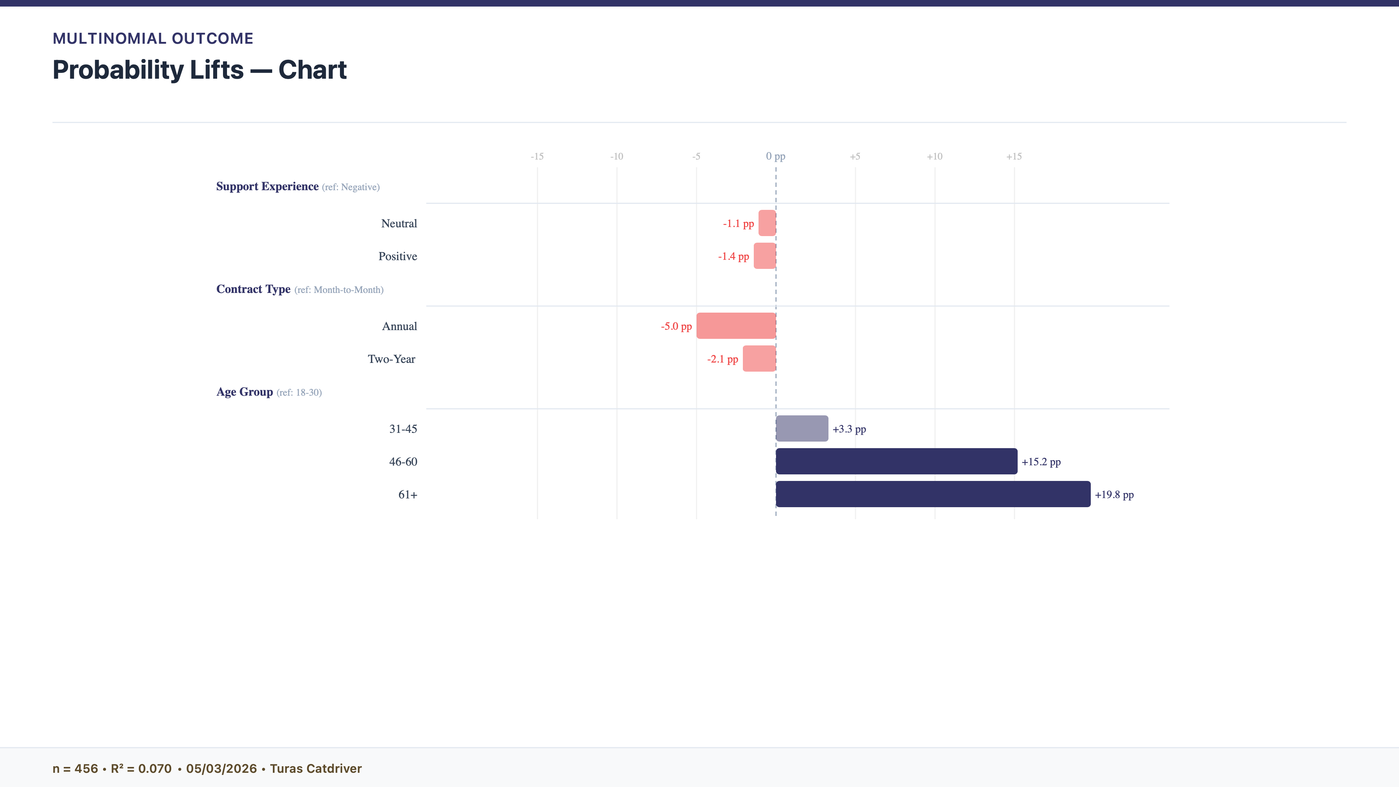
The older you are the higher the chances of satisfaction

Slide 19
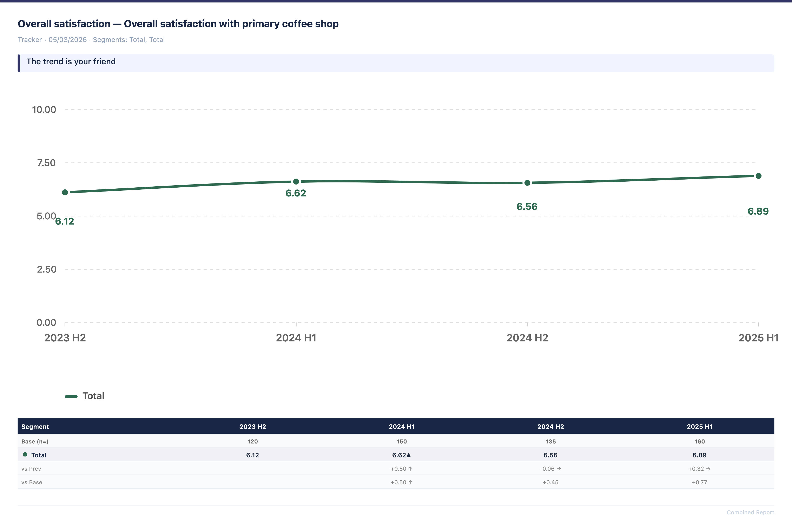
Cross wave comparison

Slide 20
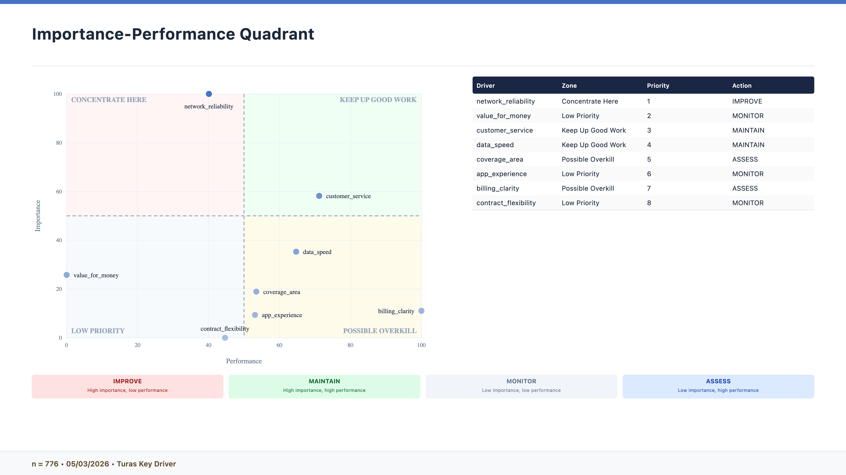
Importance performance maps

Slide 21
Thank You
Reproducible research analysis, delivered.

